Slide 1

Analyzing the Impact of Digital Learning Tools on Education Outcomes in Low-Income Countries
(Domain: Quality Education (SDG 4))

Slide 2
Dishant Naik
21MIA1127
Dazzle A J
Team
21MIA1119
Shashank Singh
21MIA1110
Vishwajeet Shewale
21MIA1056

Slide 3


Agenda
Abstract
Objective
Architecture Diagram Modules
Result
Inferences
Refernces

Slide 4

Abstract
This project investigates the impact of digital learning tools on educational outcomes, particularly focusing on literacy rates among primary school students in low-income countries. As technology becomes more integrated into education, understanding its effectiveness in resource-limited settings is essential. Using data from UNESCO, the World Bank, and national education databases, this study explores the correlation between digital learning adoption and literacy improvements, while also examining regional disparities in educational outcomes based on access to these tools. The analysis further investigates the role of internet access in enhancing the effectiveness of digital learning. By applying statistical modeling and visualization techniques, the project seeks to uncover key insights that can guide future educational strategies. Based on the findings, targeted recommendations will be provided to policymakers and educators to optimize the deployment of digital learning tools, ultimately aiming to improve education quality in low-income settings.

Slide 5

To evaluate the relationship between the adoption of digital learning tools and literacy rates among primary school students in low-income countries.
To compare and analyze educational outcomes across regions with varying levels of access to digital learning resources.
To investigate the impact of internet access on the effectiveness of digital learning tools in improving educational outcomes.
To provide evidence-based recommendations for policymakers and educators on how to optimize digital learning initiatives to enhance education quality in low-income settings.
Objective

Slide 6
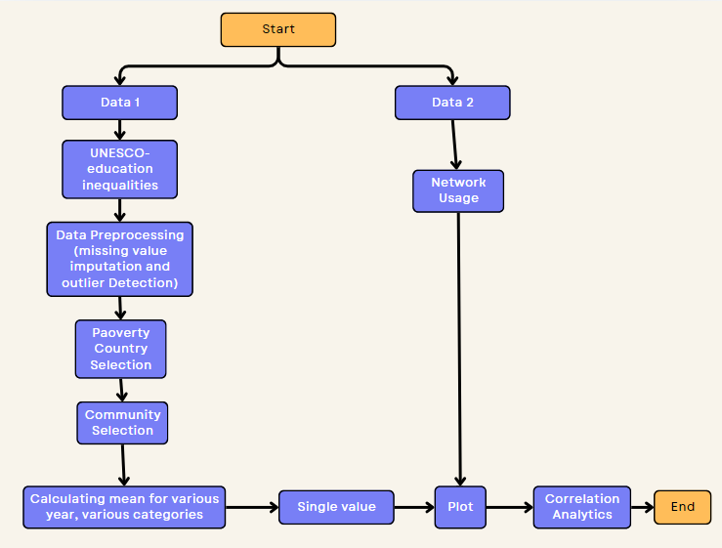
Architecture Diagram

Slide 7
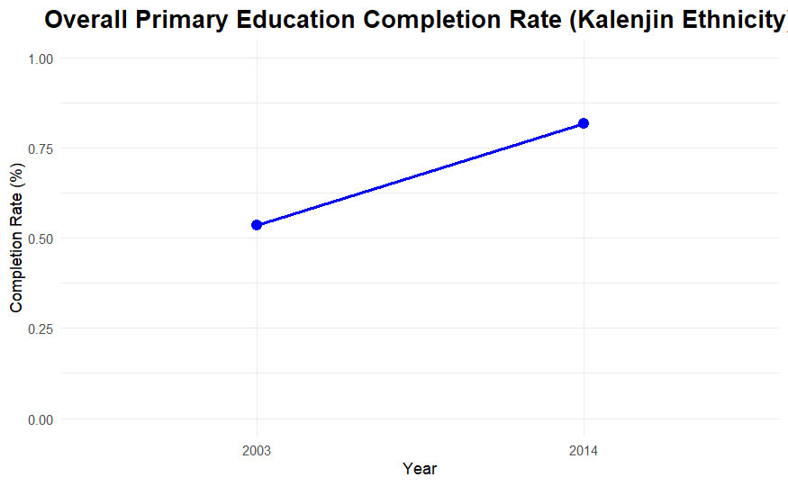
Inference: If the primary education completion rate shows an upward trend, it could suggest that efforts in increasing access to primary education in the Kalenjin community are paying off. Conversely, if the rate declines or stagnates, it may point to challenges such as lack of resources or socio-economic factors affecting school attendance at the primary level.
Results

Slide 8
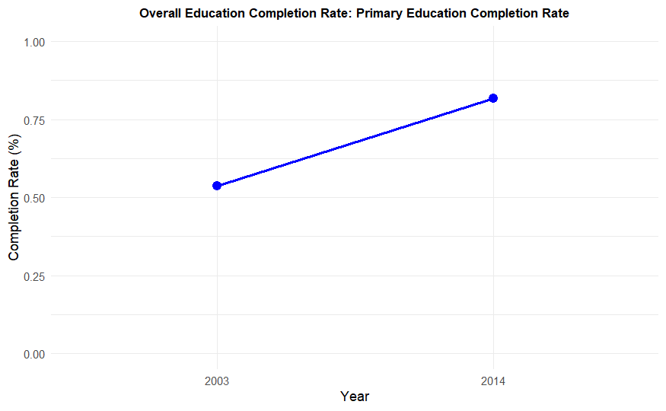
Inference: This plot will show how well students transition from primary to lower secondary education. A growing trend could indicate improvements in retention and transition programs, while a decline may suggest barriers such as costs, distance to secondary schools, or cultural factors limiting secondary education participation.
Results

Slide 9
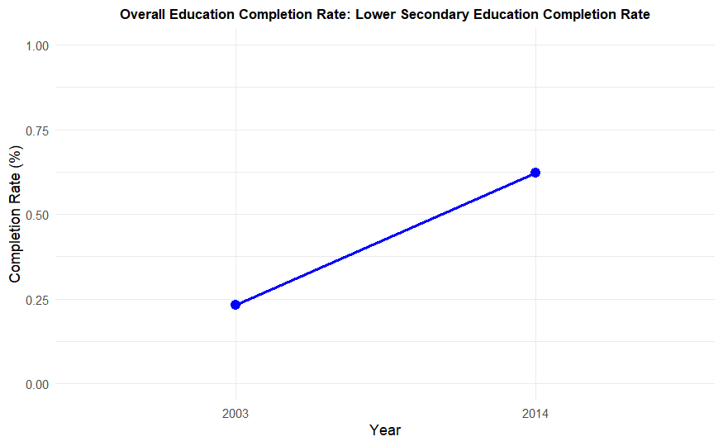
Inference: A high or increasing completion rate for upper secondary education suggests that a significant portion of the Kalenjin youth is receiving a more advanced education. A lower or declining trend might indicate that socio-economic conditions (such as the need to enter the workforce early or cultural factors) are affecting upper secondary completion.
Results

Slide 10
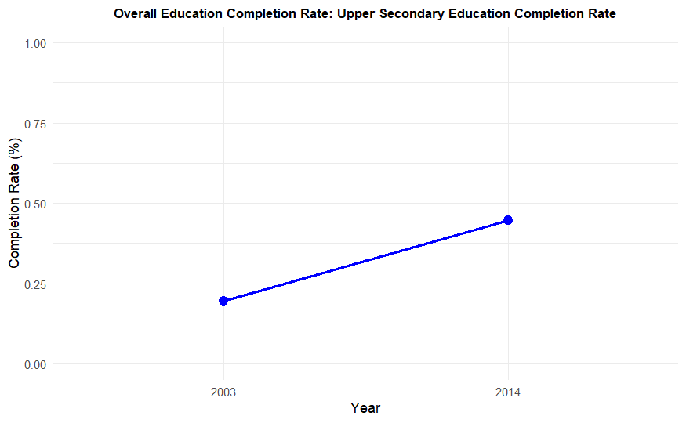
Inference: This plot focuses on older students completing primary education. An upward trend might indicate increasing opportunities for adult or late learners to complete their education, which could be a result of adult education programs or flexible learning schedules.
Results

Slide 11
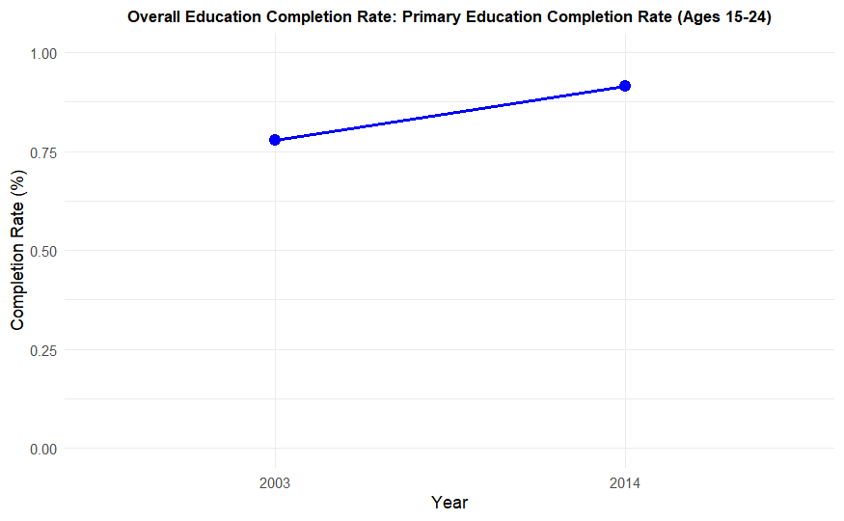
Inference: This plot provides insights into older youth completing lower secondary education. A high or increasing rate could suggest that more flexible secondary education options are available for those who may have dropped out earlier or had delayed access to schooling.
Results

Slide 12
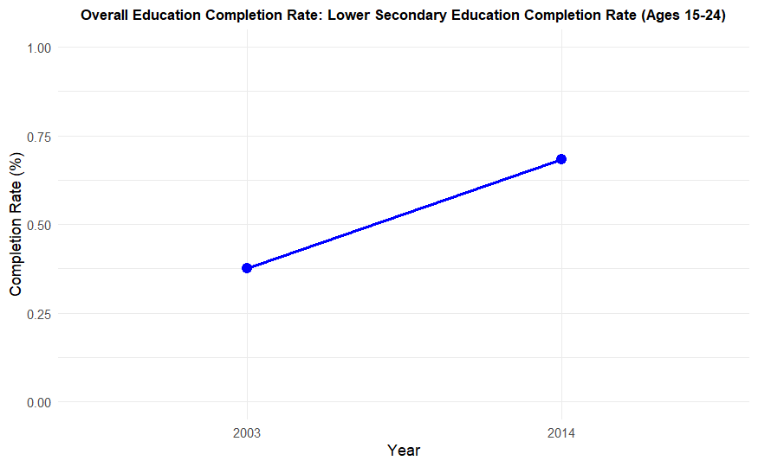
Inference: This plot reflects the success of older youth in completing upper secondary education. An upward trend could indicate that more young adults in the Kalenjin community are motivated or able to pursue secondary education, possibly due to the availability of flexible learning options or economic incentives. A flat or declining trend may indicate obstacles in continuing education after a certain age.
Results

Slide 13
Inferences
  Educational Progress Over Time: If the plots for all variables generally show an increasing trend, you can infer that educational outcomes for the Kalenjin community are improving, possibly due to better infrastructure, educational programs, and support. If some variables (like upper secondary completion) lag behind, this could signal areas where more targeted interventions are needed.
  Age-specific Trends: Comparing the general completion rates (e.g., comp_prim_v2_m, comp_lowsec_v2_m, comp_upsec_v2_m) with age-specific rates (comp_prim_1524_m, comp_lowsec_1524_m, comp_upsec_2029_m) might reveal insights into how educational opportunities evolve for different age groups. For example, older students completing primary education might suggest a robust adult education program.
  Impact of Digital Learning: If you're incorporating data on internet usage or access to digital learning tools, an upward trend in completion rates may correlate with increased access to technology. In low-income countries, digital learning tools might bridge gaps in educational resources, allowing more students to complete their schooling.
  Possible Barriers: For categories that show a stagnating or declining trend, you may want to investigate barriers like socio-economic constraints, gender disparities, or geographic isolation. Insights from other datasets (such as internet usage or government policies) might help explain why these trends are occurring.

Slide 14
Conclusion
  In conclusion, this study highlights the potential of digital learning tools to improve education outcomes, particularly in low-income countries like Kenya and Nigeria. The analysis reveals that access to digital resources, alongside stable internet connectivity, can significantly enhance literacy rates and reduce regional disparities in education. However, the effectiveness of these tools is heavily dependent on infrastructure, particularly internet access, which remains a challenge in many under-resourced areas. To optimize the impact of digital learning, policymakers must prioritize investments in digital infrastructure and ensure equitable access to technology across all regions. By addressing these challenges, digital learning can become a powerful tool in bridging educational gaps and promoting sustainable development in low-income countries.

Slide 15
References
  Dataset link: https://www.education-inequalities.org/indicators/literacy_1524/kenya/communities#year=%222022%22&ageGroup=%22literacy_1524%22&dimension1=%7B%22id%22%3A%22community%22%2C%22filters%22%3A%5B%22Rural%22%2C%22Urban%22%5D%7D
  New global data reveal education technology’s impact on learning
  https://www.ncbi.nlm.nih.gov/pmc/articles/PMC9684747/
  Abid Haleem, Mohd Javaid, Mohd Asim Qadri, Rajiv Suman,Understanding the role of digital technologies in education: A review,Sustainable Operations and Computers,Volume 3,2022,Pages 275-285,ISSN 2666-4127,https://doi.org/10.1016/j.susoc.2022.05.004.(https://www.sciencedirect.com/science/article/pii/S2666412722000137)
  Rafiq, Shahid & Iqbal, Saleem & Afzal, Dr. (2024). The Impact of Digital Tools and Online Learning Platforms on Higher Education Learning Outcomes.
  Sandra Barteit, Dorota Guzek, Albrecht Jahn, Till Bärnighausen, Margarida Mendes Jorge, Florian Neuhann,Evaluation of e-learning for medical education in low- and middle-income countries: A systematic review,Computers & Education,Volume 145,2020,103726,ISSN 0360-1315,https://doi.org/10.1016/j.compedu.2019.103726.(https://www.sciencedirect.com/science/article/pii/S0360131519302799)

Slide 16
Thank You

